Slide 1
Measuring Corporate Culture Using Machine Learning
Kai Li University of British Columbia
Feng Mai Stevens Institute of Technology
Rui Shen The Chinese University of Hong Kong
Xinyan Yan
University of Dayton
Presented by Austin Francis

Slide 2
Research Question
Does corporate culture affect firm outcomes, and can it be accurately measured using machine learning techniques applied to earnings calls?

Slide 3
Prior Literature
Previous studies on the relationship between corporate culture and firm policy have primarily relied on proxies or survey/interview data.
Most textual analysis methods operate at the document level, treating words as independent tokens, ignoring their order and context (the "bag-of-words" assumption).
Supervised learning methods need labeled observations, typically in the form of firm outcomes, as training examples, while unsupervised learning keeps human input to a minimum.

Slide 4
Hypothesis
Cultural values relate to business outcomes in all dimensions (operational efficiency, risk-taking, earnings management, executive compensation design, and firm value).
Cultural values play an important role in M&A activity and merger pairings (cultural similarity hypothesis).
Post-merger acquirer cultural values are positively associated with target firm pre-merger cultural values (acculturation hypothesis).

Slide 5
Data Collection
209,480 Question and Answer sections of earnings call transcripts from the Thomson Reuters StreetEvents database between January 1, 2001, and May 25, 2018.

Slide 6
Results
A new semisupervised machine learning approach successfully generated a culture dictionary and quantified corporate culture for 62,664 firm-year observations from 2001-2018 using the five cultural values proposed by Guiso, Sapienza, and Zingales (2015): innovation, integrity, quality, respect, and teamwork
The new measure of corporate culture outperforms three alternative measures.

Slide 7
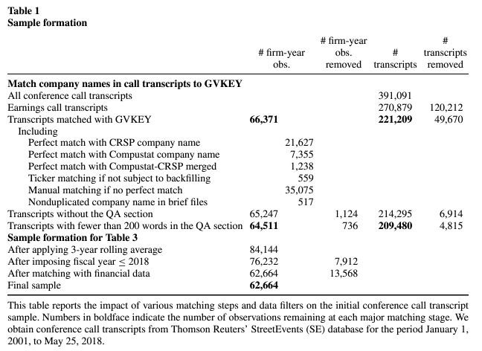
Notes:
What It Shows: This table outlines the step-by-step process of refining the initial dataset of conference call transcripts to arrive at the final sample used in the study. It shows how many transcripts were excluded at each stage and the criteria used for exclusion.
Okay, everyone, let's take a look at Table 1, which is titled "Sample Formation." This table is important because it lays out exactly how the researchers went from a large set of conference call transcripts to the final sample they used to study corporate culture.
The researchers started with a massive dataset of 391,091 conference call transcripts from the Thomson Reuters StreetEvents database.1
●
Their first step was to focus specifically on earnings calls, as they believed these calls would be the most informative about a company's culture.12 They were left with 270,879 transcripts after removing other types of conference calls.1
●
Next, they had to match the companies mentioned in these transcripts to a unique identifier in financial databases, like Compustat, to get financial information about each company.13 This involved a lot of meticulous work, like comparing company names, ticker symbols, and even manual matching.1
●
After this matching process, they were left with 66,371 earnings call transcripts.1
It's worth noting that they specifically chose to use the Question and Answer (QA) section of these earnings calls.34 Why? Well, they argue that the QA section is more spontaneous and less scripted, making it harder for management to "window dress" or artificially present their culture in a positive light.34
●
They removed transcripts that didn't have a QA section or where the QA section was too short to be meaningful.13
●
Finally, they applied a few more filters to ensure data quality.1 For example, they removed observations with missing financial data and calculated 3-year rolling averages for their cultural values.15
This rigorous process resulted in a final sample of 62,664 firm-year observations — a substantial amount of data to analyze the relationship between corporate culture and various firm outcomes.15
copy_all
thumb_up
thumb_down
keep_pinSave to note

Slide 8
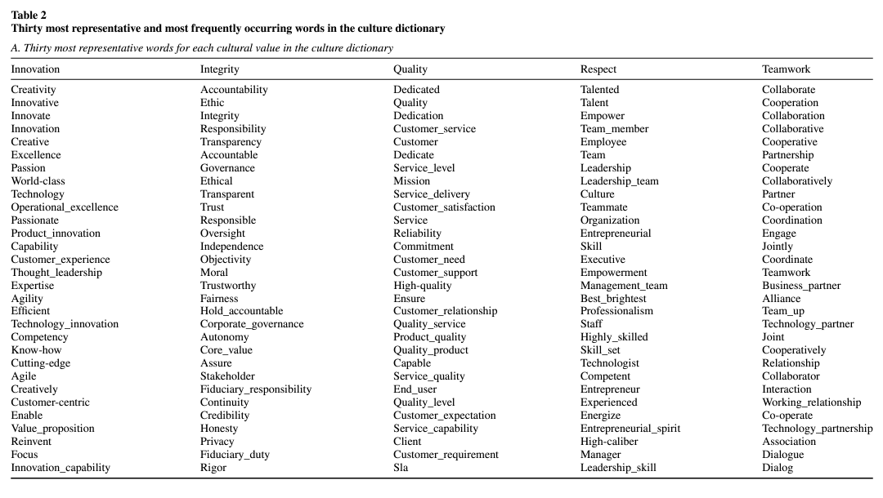
Notes:
What It Shows: This table presents the top 30 words most strongly associated with each of the five cultural values (innovation, integrity, quality, respect, and teamwork) based on the word embedding model. It also shows the top 30 most frequently occurring words within the culture dictionary for each value, along with their weighted frequency.
This table really gets into the details of how the researchers used this machine learning technique called word embedding to actually measure corporate culture.
The table is split into two parts. Panel A is all about finding the most representative words for each of the five cultural values.
●
Remember, the researchers are trying to capture the unique language that companies use to signal their culture in earnings calls.
●
They start with a set of "seed words" for each value – these are words that are commonly associated with each cultural dimension.
●
Then, the word embedding model analyzes the entire corpus of earnings calls and identifies words that are used in similar contexts as those seed words. It's like the model is learning the subtle relationships between words based on how they're actually used in conversations.
So, for example, if you look at the "Innovation" column, you see words like "creativity," "technology," and "product_innovation" – words that clearly evoke a sense of novelty and forward-thinking.
●
This is a lot more sophisticated than just looking at the most frequently used words, because it's taking into account the meaning of the words within the specific context of corporate communications.

Slide 9
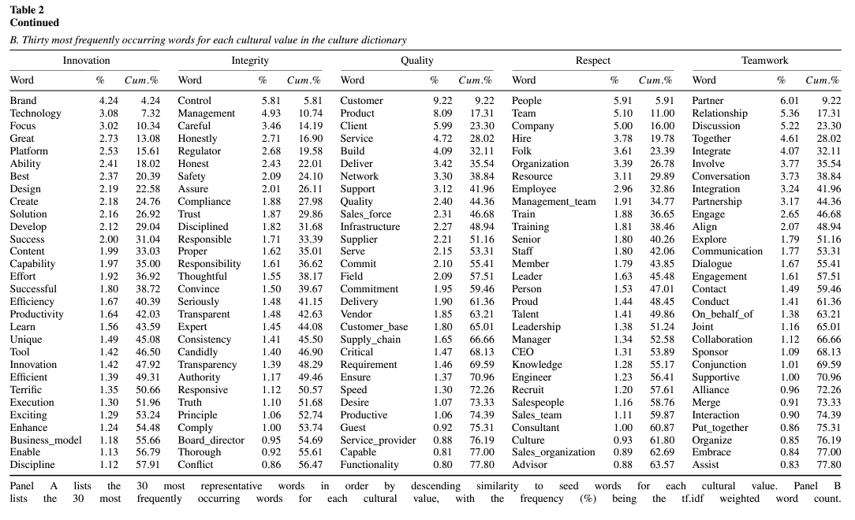
Notes:
Now, Panel B of the table shows the 30 most frequently occurring words for each value.
●
You'll notice that some words appear in both panels, but there are also some interesting differences.
●
This highlights the fact that word embedding goes beyond simple word counts to capture the deeper semantic associations between words.
For instance, take a look at the word "control" in the "Integrity" column of Panel B. It's used quite frequently, but it doesn't appear in Panel A, which lists the most representative words for integrity.
●
This suggests that while "control" might be a common theme in discussions of integrity, it's not necessarily the most distinctive or insightful term when it comes to understanding a company's ethical values.
Overall, Table 2 gives us a glimpse into the language of corporate culture. It shows how machine learning can help us uncover the subtle ways that companies communicate their values through the words they choose. And it reminds us that language is complex – sometimes the most frequent words aren't the most meaningful ones, and it takes a nuanced approach like word embedding to truly understand what companies are trying to say.
copy_all
thumb_up
thumb_down
keep_pinSave to note

Slide 10
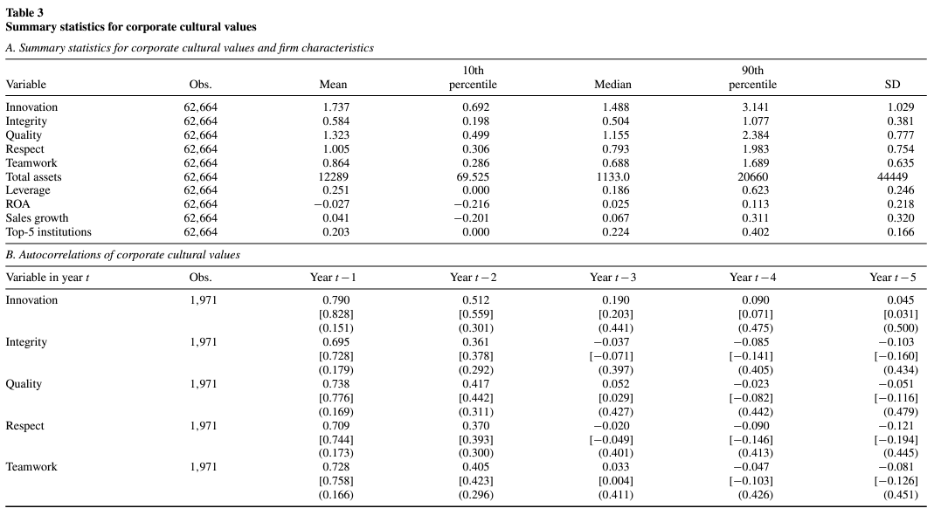
Notes:
This table is like a snapshot of the final dataset, providing a summary of the key variables and their characteristics.
The first thing to highlight is the sample size. Panel A of Table 3 tells us that the final sample includes 7,501 firms and 62,664 firm-year observations. This is a substantial amount of data, which gives us confidence in the generalizability of the study's findings.
The table then presents summary statistics for each of the five cultural values, measured using the word embedding technique discussed earlier. These statistics give us a sense of how prevalent each cultural value is in the sample and how much variation there is across firms.1
●
For instance, we can see that Innovation is the most frequently mentioned cultural value in earnings calls, with a mean score of 1.73. This is consistent with findings from previous studies that have shown a strong emphasis on innovation in corporate communications.1
●
On the other hand, Integrity has the lowest mean score (0.58), suggesting that it might be a less prominent theme in earnings calls.1
Panels B and C provide insights into the relationships between the cultural values and other variables. This helps us understand how corporate culture might be related to firm performance, risk, and other characteristics.
●
Panel B shows the autocorrelations for each cultural value over time, which suggests that a firm's culture tends to be relatively stable over a 3-year period.

Slide 11
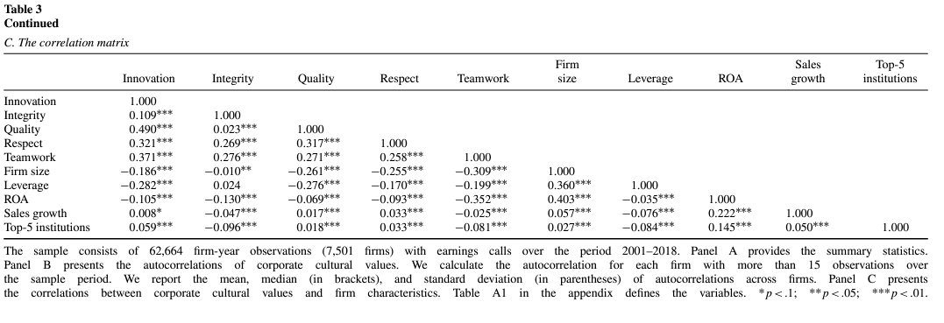
Notes:
●
Panel C presents a correlation matrix, showcasing the relationships between the five cultural values and firm characteristics.3 For example, the positive correlation between innovation and firm size suggests that larger firms may tend to place more emphasis on innovation.3 Conversely, the negative correlation between integrity and leverage indicates that firms with higher debt levels might be less likely to prioritize ethical values.3 These correlations provide a preliminary glimpse into how corporate culture might be intertwined with other aspects of a firm's operations and strategy.

Slide 12
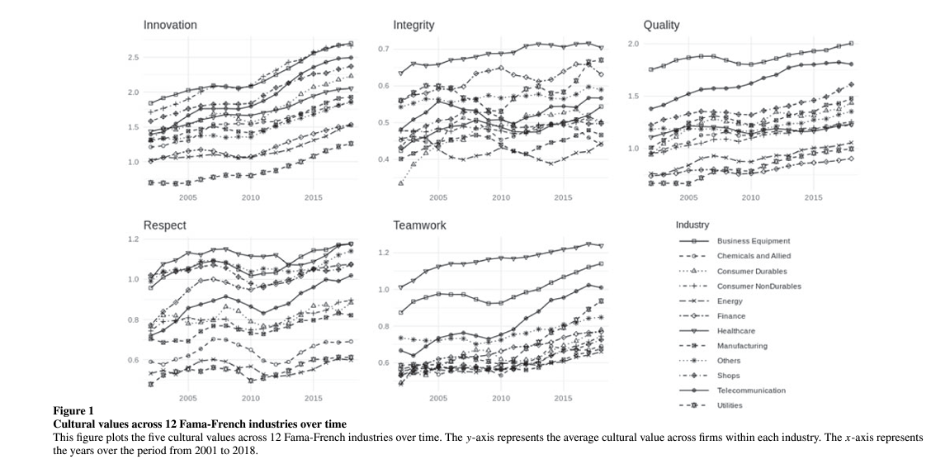
Notes:
●
A General Upward Trend in Innovation: Across most industries, there is a notable increase in the average score for innovation over the sample period. This suggests a growing emphasis on technology and innovation in the corporate world, reflected in the language used during earnings calls. This trend is likely driven by the increasing importance of technological advancements and their impact on business operations and competitiveness1.
●
Healthcare's Focus on Integrity and Teamwork: The healthcare industry stands out with consistently high scores for integrity and teamwork throughout the sample period. This emphasis on ethical conduct and collaborative efforts is likely reflective of the nature of the healthcare industry, where patient well-being and safety are paramount concerns1.
●
Business Equipment's Emphasis on Quality: The business equipment industry maintains the highest scores for quality across all three subperiods. This focus on delivering high-quality products is consistent with the industry's focus on providing reliable and durable equipment for business operations1.

Slide 13
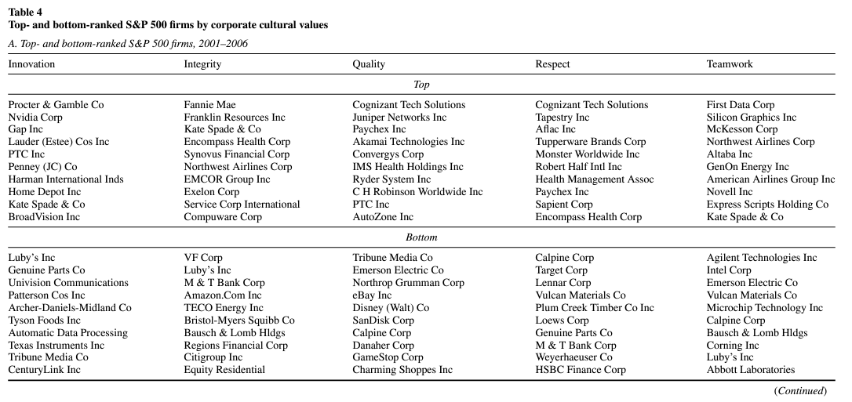
Notes:
Table 4 takes us from the broad analysis of the entire sample to a more focused look at individual companies. Specifically, it highlights the top-ranked and bottom-ranked S&P 500 companies based on each of the five cultural values. The table is broken down into three panels, each covering a different time period: 2001-2006, 2007-2012, and 2013-2018.
●
This allows us to see how the cultural landscape of leading companies has evolved over time.
●
It's also interesting to see which companies consistently appear at the top or bottom of the rankings, and which ones show significant changes.
For instance, if you look at the Innovation ranking, you'll notice that Nvidia appears in the top spot for both the 2007-2012 and 2013-2018 periods.
●
This suggests that Nvidia has cultivated a strong culture of innovation over a prolonged period, which is likely reflected in its products and market performance.
●
On the other hand, some companies like Procter & Gamble and First Data Corp were top-ranked for innovation in the earlier period but don't feature in the later periods. This could signal shifts in their strategic focus or changes in how they communicate about innovation in their earnings calls.
Another noteworthy observation is the presence of Cognizant Technology Solutions at the top of both the Integrity and Respect rankings in the 2001-2006 period.
●
This highlights the point that a company can excel in multiple cultural dimensions, and that these values are not mutually exclusive.
It's also intriguing to examine the bottom-ranked companies and consider the potential implications of their cultural profiles. For example, Lennar Corp appears in the bottom ranks for both Integrity and Quality in the 2001-2006 period.
●
While this doesn't necessarily imply that these companies are engaging in unethical or subpar practices, it does raise questions about how they perceive and communicate about these values.
●
It also underscores the importance of considering a company's cultural profile alongside its financial performance and other metrics when making investment or other strategic decisions.
Looking at the changes over time can also reveal broader trends in corporate culture. For example, in the most recent period (2013-2018), we see companies like Netflix, Blackrock, and Salesforce dominating the top rankings for various cultural values.
●
These are all companies known for their innovative business models and rapid growth, suggesting a possible link between certain cultural values and the ability to thrive in dynamic and disruptive environments.

Slide 14
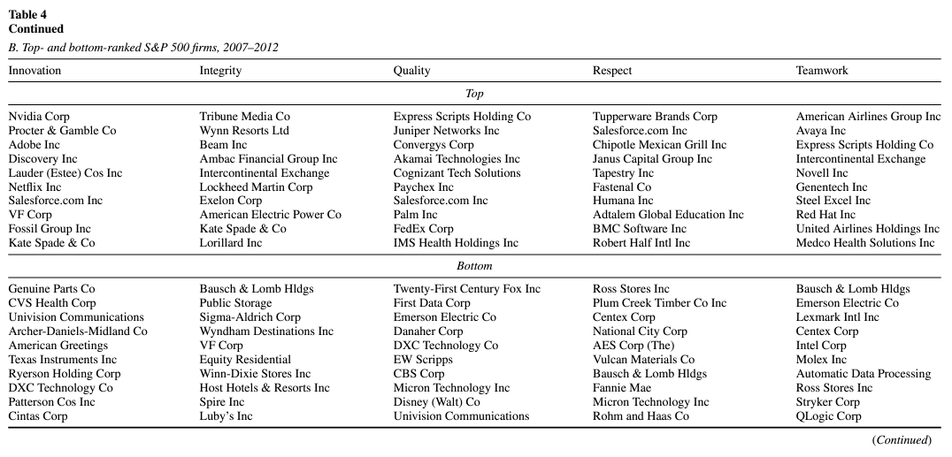

Slide 15
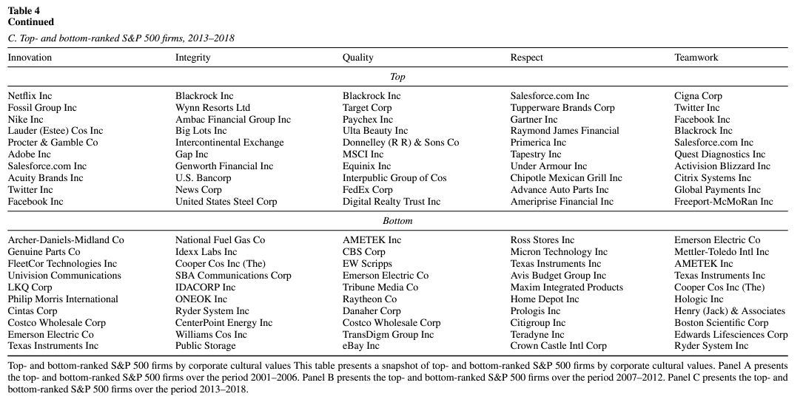

Slide 16
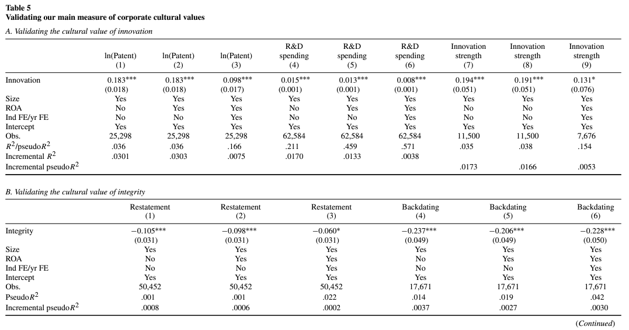
Notes:
This is where the researchers put their measures of corporate culture to the test, trying to validate them by linking them to concrete outcomes.
●
It's one thing to identify words and phrases that might signal different cultural values, but it's quite another to demonstrate that these measures actually have real-world implications.
The table is structured into five panels, each focusing on a different cultural value and its associated outcomes.
●
Panel A examines Innovation. The researchers use three different measures of corporate innovation activities: R&D spending, the number of patents filed, and an "innovation strength" measure that takes into account the quality and impact of those patents.
●
Across all three measures and various model specifications (including controls for firm size, profitability, and industry trends), they find a positive and significant association between the cultural value of Innovation and actual innovation activities. This provides compelling evidence that their measure of Innovation is capturing something meaningful about a company's commitment to developing new products and technologies.
Panel B focuses on Integrity, and here the researchers look at two measures of potentially unethical behavior: financial restatements and the backdating of executive stock options.
●
They find a negative and significant relationship between the cultural value of Integrity and both of these measures. In other words, companies that score higher on Integrity are less likely to engage in these questionable practices. This again supports the validity of their measure and suggests that it can help identify companies with a stronger ethical compass.

Slide 17
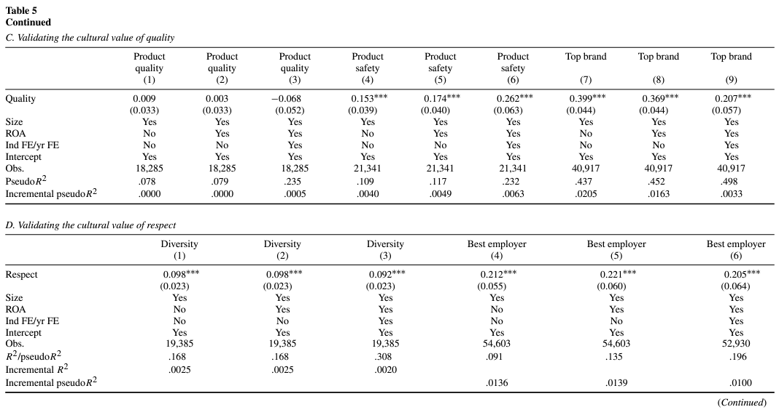
Notes:
Panel C examines Quality. The researchers use three measures to assess the quality of a company's products and services: product safety, whether the company is considered to have strengths in product quality based on KLD ratings, and whether the company has a top brand.
●
They find a positive and significant association between the cultural value of Quality and two out of the three measures (product safety and top brand). The relationship with the overall product quality measure is not statistically significant.
Panel D explores Respect. The researchers use two measures to assess this value: diversity scores based on KLD ratings and whether the company is included in Fortune's list of "100 Best Companies to Work For."
●
They find a positive and significant association between the cultural value of Respect and both measures, indicating that companies that emphasize respect are more likely to have diverse workforces and to be considered desirable employers.

Slide 18
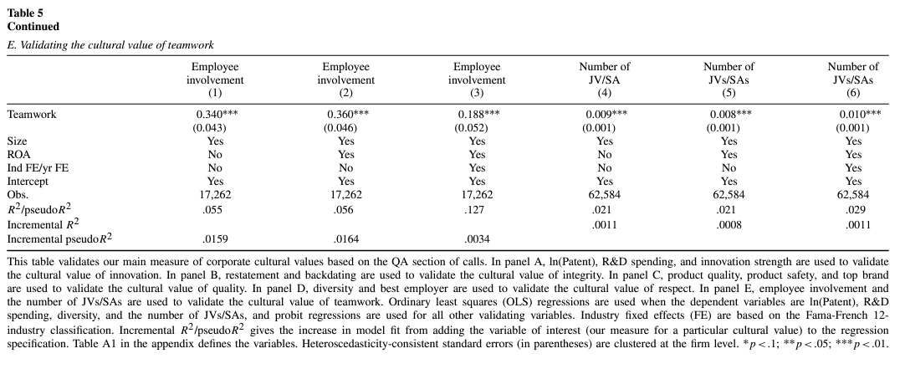
Notes:
Finally, Panel E looks at Teamwork, using two measures: employee involvement based on KLD ratings and the number of joint ventures and strategic alliances a company has formed.
●
They find a positive and significant association between the cultural value of Teamwork and both measures, suggesting that companies with strong teamwork cultures are more likely to engage their employees and to collaborate effectively with external partners.

Slide 19
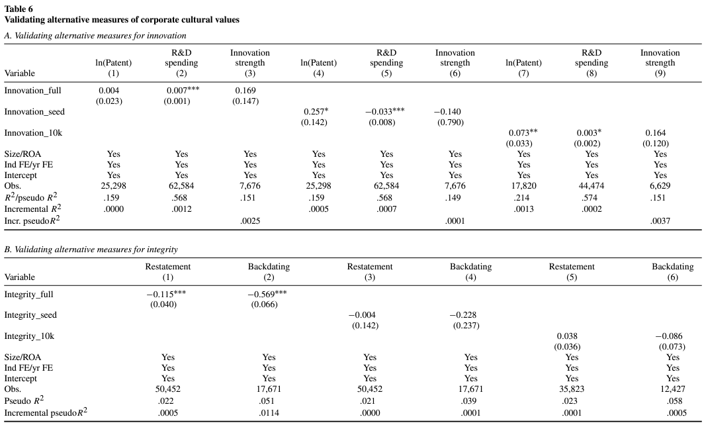
Notes:
Table 6 builds upon the validation efforts presented in Table 5 by exploring alternative ways to measure corporate culture. It's like a "second opinion" on the researchers' main measure, helping to assess the robustness of their findings and to determine whether their preferred method (using the Q&A section of earnings calls) is truly the most effective approach.
The table examines three alternative measures of corporate culture:
●
Culture_full: This measure uses the entire earnings call transcript, including both the management presentation and the Q&A section. This is compared to the main measure, which only uses the Q&A section.
●
Culture_seed: This measure relies on a simple count of the seed words (and their synonyms) used to define each cultural value. It doesn't incorporate word embeddings or the tf-idf weighting scheme.
●
Culture_10k: This measure applies the word embedding model to the Management Discussion and Analysis (MD&A) section of companies' 10-K filings. This assesses whether the researchers' method can be generalized to other types of corporate disclosures.

Slide 20
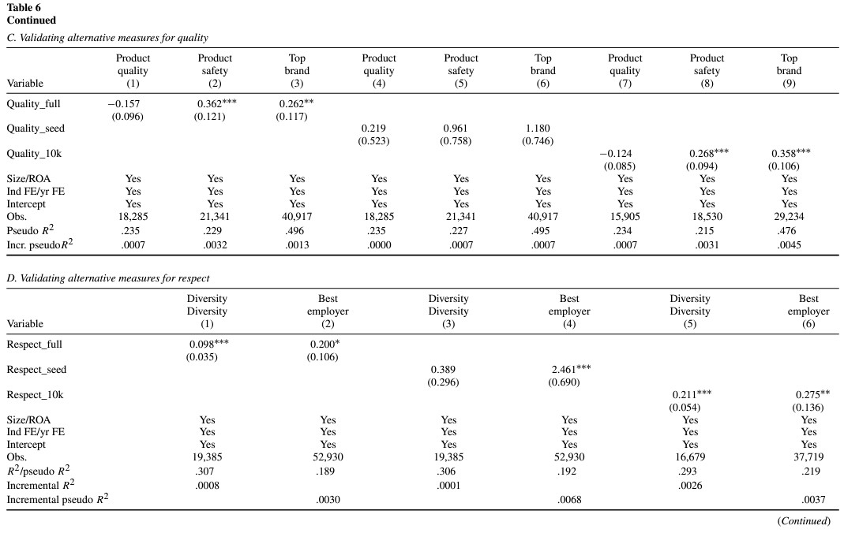

Slide 21
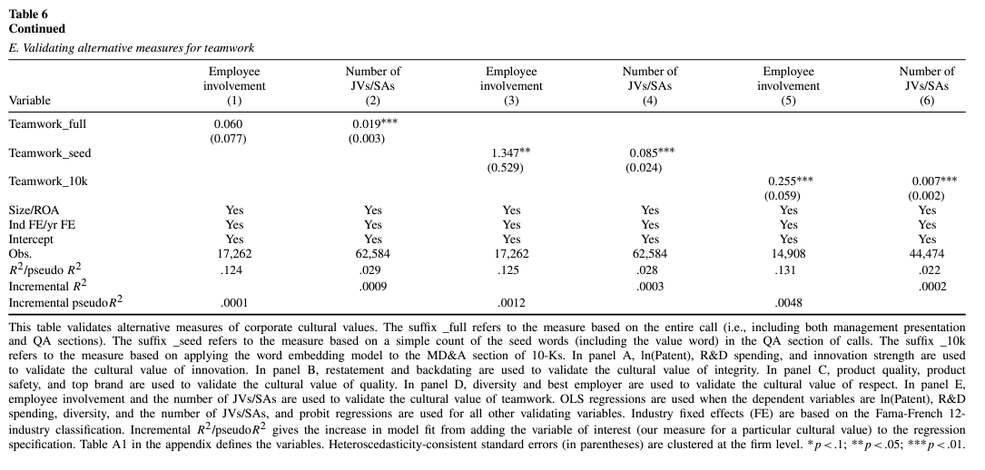
Notes:
The key takeaway from Table 6 is that the researchers' main measure (based on the Q&A section of earnings calls) generally outperforms the three alternative measures. This is indicated by larger coefficient magnitudes and higher levels of statistical significance for the main measure in most cases.
●
The alternative measure based on the full earnings call (Culture_full) comes in as a close second, but it still doesn't quite match the performance of the main measure.
●
The measure based on a simple count of seed words (Culture_seed) performs the worst, suggesting that the more sophisticated techniques of word embeddings and tf-idf weighting are indeed valuable for capturing nuances in corporate culture.
●
The measure based on 10-K filings (Culture_10k) shows mixed results, with some significant relationships but generally weaker performance compared to the measures derived from earnings calls. This suggests that the researchers' method might be applicable to other types of qualitative disclosures but that earnings calls seem to be a particularly rich source of information about corporate culture.

Slide 22
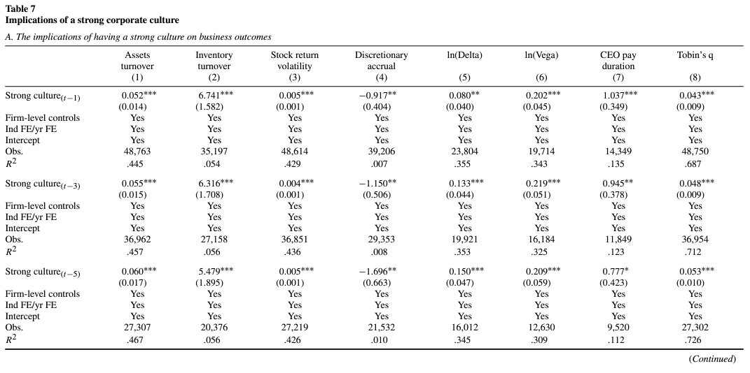
Notes:
Table 7 shifts the focus from validating the culture measures to exploring the implications of having a strong corporate culture. Specifically, it examines how a strong overall culture, as measured by the average of the five cultural values, relates to various business outcomes. The table is divided into two panels:
Panel A focuses on the general relationship between a strong culture and business outcomes, examining metrics like asset turnover, inventory turnover, stock return volatility, discretionary accruals, CEO pay duration, Tobin's Q, and sales growth.
●
Panel B zooms in on the impact of a strong culture during challenging times, analyzing abnormal stock returns during the 2008 financial crisis and the BP oil spill in 2010.
The results indicate that a strong corporate culture is associated with several positive business outcomes:
●
Higher asset turnover: This suggests that companies with strong cultures are more efficient in utilizing their assets to generate sales.1
●
Lower stock return volatility: This implies that companies with strong cultures are perceived as less risky by investors, potentially leading to a lower cost of capital.1
●
Higher Tobin's Q: This indicates that companies with strong cultures are valued more highly by the market relative to their book value of assets.1
●
Longer CEO pay duration: This suggests that companies with strong cultures are more likely to have long-tenured CEOs, which could contribute to stability and long-term strategic focus.1

Slide 23
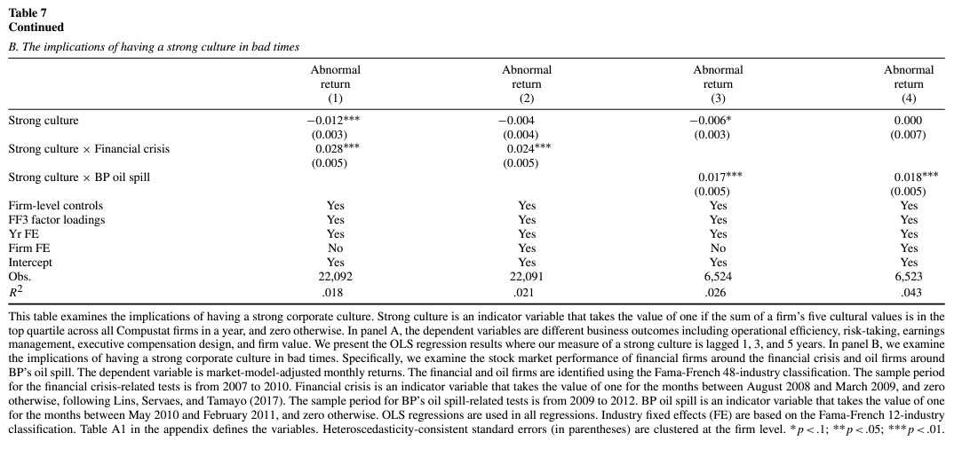
Notes:
Panel B: The Impact of a Strong Culture in Bad Times
Panel B of Table 7 examines whether a strong corporate culture provides benefits during times of crisis. The researchers focus on two specific events:
●
The 2008 financial crisis: They analyze abnormal stock returns for firms with and without strong cultures during this period.4
●
The BP oil spill in 2010: They examine abnormal stock returns for oil companies with and without strong cultures during this period.4
The key finding from Panel B is that companies with strong cultures tend to perform better during crises. This is evidenced by the positive and significant coefficients on the interaction terms "Strong culture × Financial crisis" and "Strong culture × BP oil spill."4
The sources highlight that the regressions in Panel B control for various firm-level characteristics, as well as industry fixed effects. They also note that the standard errors are clustered at the firm level to account for potential correlation within firms over time.45
Overall, Table 7 suggests that a strong corporate culture can have a meaningful impact on business outcomes, both in general and during times of crisis. This reinforces the idea that culture is not just a "soft" concept but rather a strategic asset that can contribute to a company's success.

Slide 24
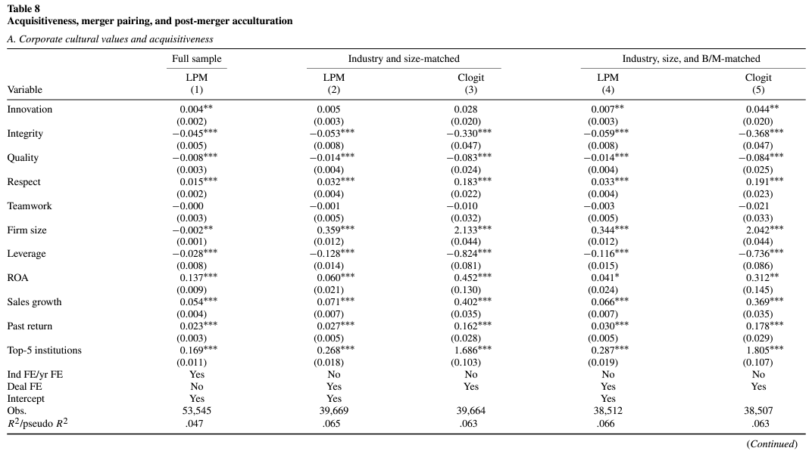
Notes:
Table 8 shifts the focus from the general impact of corporate culture on business outcomes to a more specific exploration of its role in mergers and acquisitions (M&A). The table examines several key aspects of this relationship:
●
Panel A: Deal Incidence - This panel explores whether certain cultural values make a company more likely to become an acquirer.
●
Panel B: Merger Pairing - This panel investigates whether companies with similar corporate cultures are more likely to merge with each other, testing the "cultural fit" hypothesis.
●
Panel C: Post-Merger Acculturation - This panel examines how the corporate cultures of the acquirer and target firm evolve after a merger.
●
Full sample: Includes all firm-years with cultural values from the Compustat database.
●
Industry and size-matched: Compares acquirers to control firms matched on industry and size.
●
Industry, size, and B/M matched: Compares acquirers to control firms matched on industry, size, and book-to-market ratio.
Two different statistical models are employed:
●
Linear probability model (LPM)
●
Conditional logit model (Clogit)
The key findings from Panel A are:
●
Innovation: A positive and significant association with deal incidence in most models, suggesting that companies that emphasize innovation are more likely to be acquirers. This could be because innovative companies are more likely to see M&A as a way to acquire new technologies or expand into new markets.
●
Integrity: A negative and significant association with deal incidence in all models, indicating that companies that prioritize integrity are less likely to be acquirers. This could be because these companies are more cautious and selective in their M&A activity, focusing on deals that align with their ethical principles.
●
Quality: A negative and significant association with deal incidence in most models. This finding is somewhat surprising but could potentially be explained by high-quality firms being more likely to grow organically rather than through acquisitions.

Slide 25
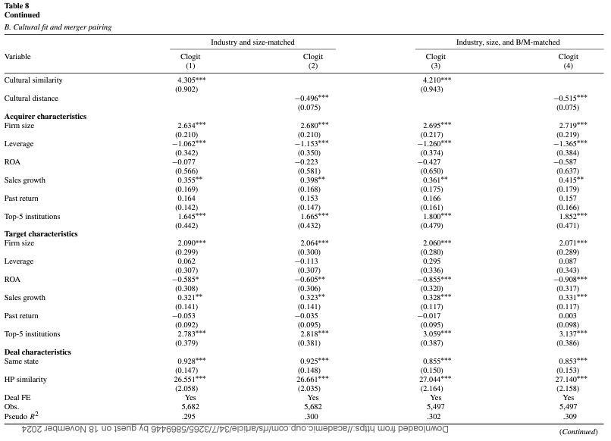
Notes:
Panel B of Table 8 explores the relationship between cultural fit and merger pairing. This panel analyzes whether companies with similar cultural values are more likely to merge.
The dependent variable is an indicator variable equal to one if the acquirer-target pair has a high cultural fit, and zero otherwise.
The key independent variables are:
●
Cultural distance: Measures the absolute difference in cultural values between the acquirer and target.
●
Acquirer and target cultural values: Individual cultural value scores for both the acquirer and the target.
●
Control variables: Include acquirer and target firm characteristics (e.g., size, leverage, profitability, sales growth, past stock returns) and deal characteristics (e.g., whether the firms are in the same state, Herfindahl-Hirschman Index (HHI) similarity).
The key findings from Panel B are:
●
Cultural distance: A negative and significant association with merger pairing, meaning that acquirers are more likely to choose targets with similar cultural values.
●
Acquirer and target cultural values: Support the "cultural fit" hypothesis, with acquirers and targets tending to have similar scores for innovation, quality, respect, and teamwork.
The regressions in Panel B include deal fixed effects to control for deal-specific factors.

Slide 26
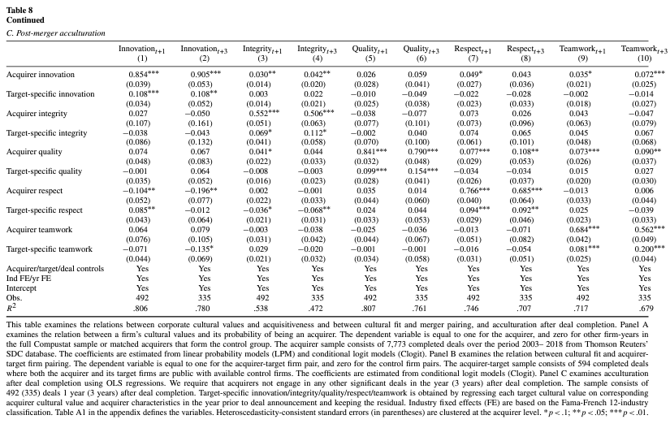
Notes:
Panel C: Post-Merger Acculturation
Panel C of Table 8 investigates how the corporate cultures of the acquirer and target firm evolve after a merger. The researchers focus on understanding the process of "acculturation," which refers to the changes in cultural values that occur as the two companies integrate.
To isolate the target-specific culture from pre-merger cultural alignment, the researchers use a two-step process:
1.
Target-specific cultural value: Regress each target's cultural value on the corresponding acquirer cultural value and acquirer characteristics in the year before the deal announcement. The residual from this regression represents the target-specific cultural value.
2.
Post-merger cultural value: Regress the acquirer's cultural value (one and three years after the merger) on both the acquirer's and target's pre-merger cultural values, including the target-specific cultural value calculated in step 1.
The key findings from Panel C are:
●
Acquirer's cultural values: Remain significantly related to their own pre-merger values even after controlling for the target's culture, indicating that the acquirer's existing culture continues to exert influence.
●
Target's cultural values: Have a significant positive association with the acquirer's post-merger culture, even when considering the target-specific cultural value, suggesting that the target firm's culture also contributes to shaping the merged entity's culture.
These findings support the hypothesis that mergers lead to the creation of a new, jointly determined culture, as opposed to the acquirer's culture completely dominating.

Slide 27
Conclusion
Corporate culture, as measured through the language used in earnings calls, is a significant predictor of various business outcomes.
Cultural fit is a crucial factor in M&A success.
Machine learning techniques, specifically word embedding, offer a powerful tool for measuring and analyzing corporate culture.
Notes:
Corporate culture, as measured through the language used in earnings calls, is a significant predictor of various business outcomes.

